Slide 1

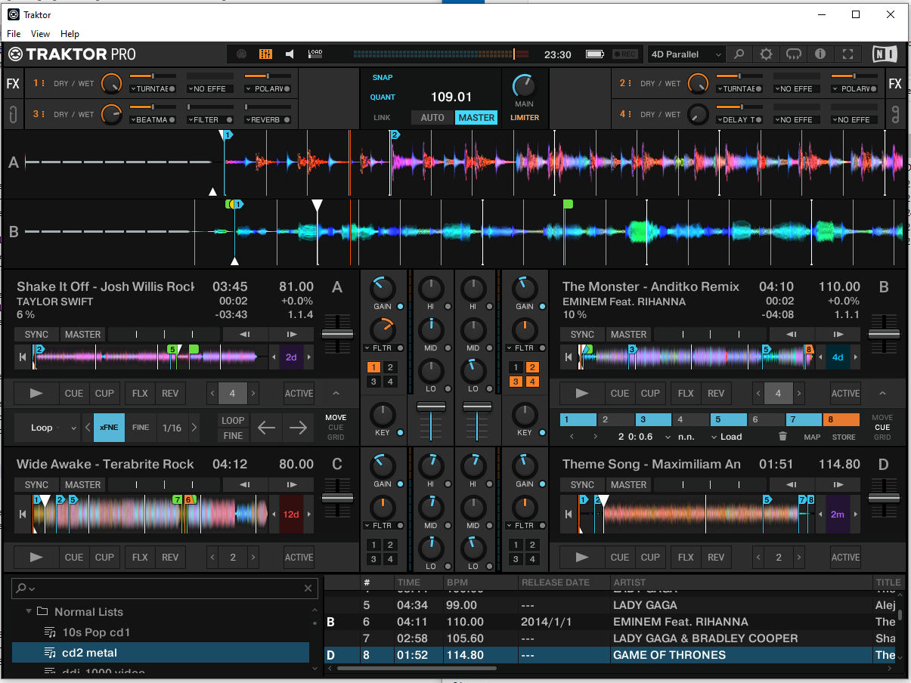
5x layouts
A/B Parallel
C/D Classic

